Slide 1
tPads: Transparent-Display Tablet Computers
CHI 2014
#submission XXXX

Slide 2
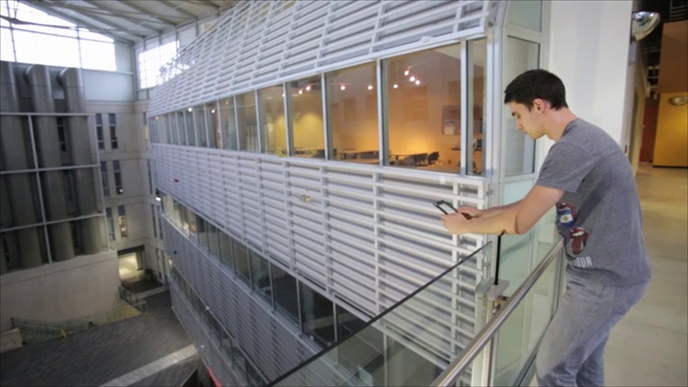
Notes:
tPads are mobile tablet computers with transparent displays that offer new interaction possibilities.

Slide 3
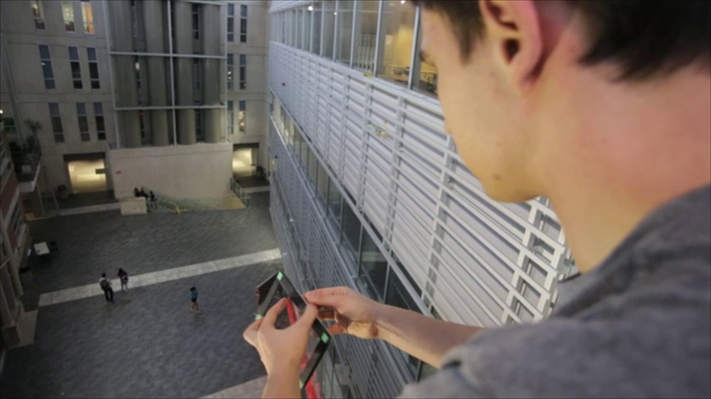
Notes:
For instance users can have different programs running on each side of the tPad,
and use a tap gesture to move content from one side to the other.

Slide 4
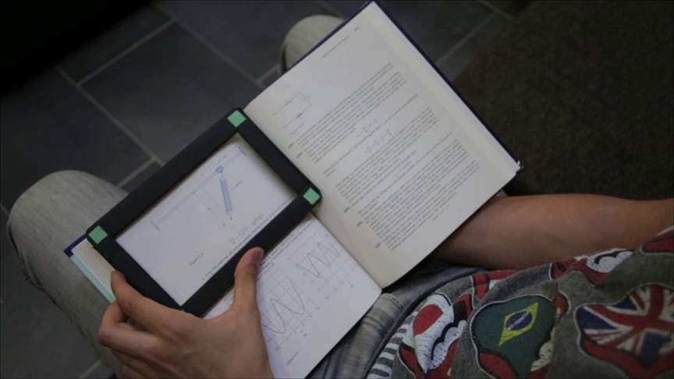
Notes:
When equipped with surface capture capabilities, users can grab a picture of the underlying object by simply placing the tPad on top of it.

Slide 5
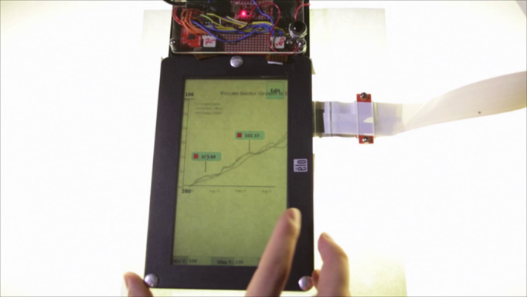
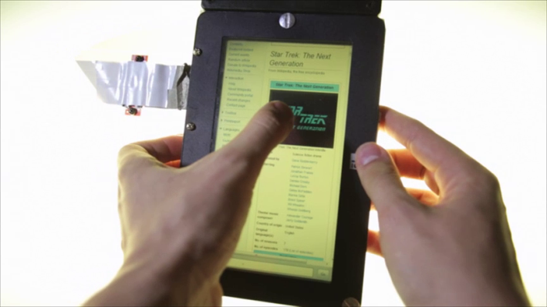
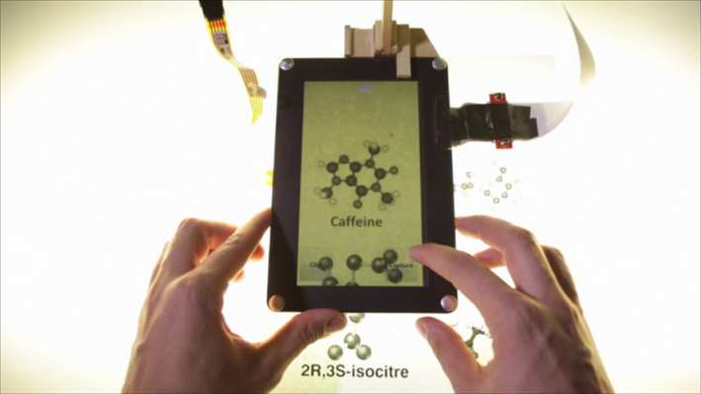
Overlay
Dual-side Input/Output
Capture
Model
Notes:
We present 4 categories of interactions for transparent display tablets.

Slide 6
Overlay
Dual-side Input/Output
Capture
Model
Notes:
The first category is overlay interactions….

Slide 7
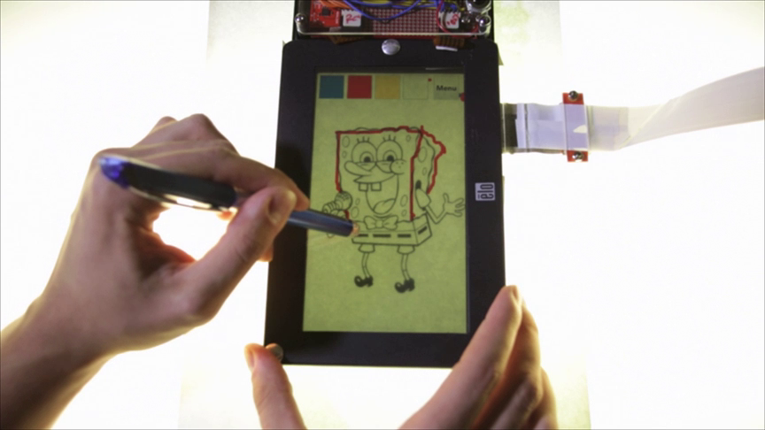
Overlay \ Tracing
Notes:
…where users simply place the tPad on top of a physical object and manually superimpose content on it.
For example, users can trace an image directly through the transparent display.

Slide 8
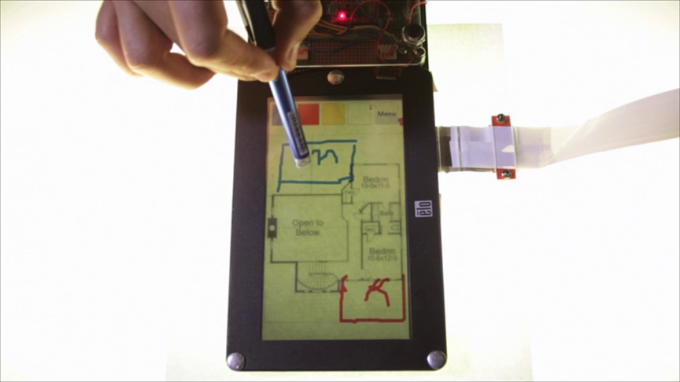
Overlay \ Tracing (collaborative)
Notes:
Users can also collaborate and suggest changes to a physical blueprint without damaging it.

Slide 9
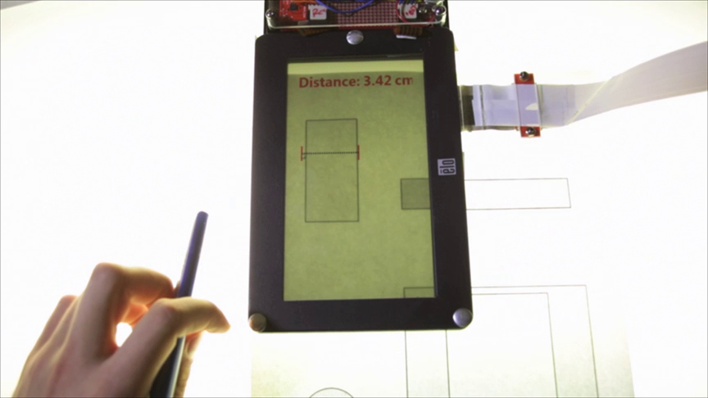
Overlay \ Querying \ Ruler
Notes:
Another possibility is to exploit the match between the display dimensions and the real world to perform physical queries.
For example, a Ruler application is used to manually measure the dimensions of printed objects.

Slide 10
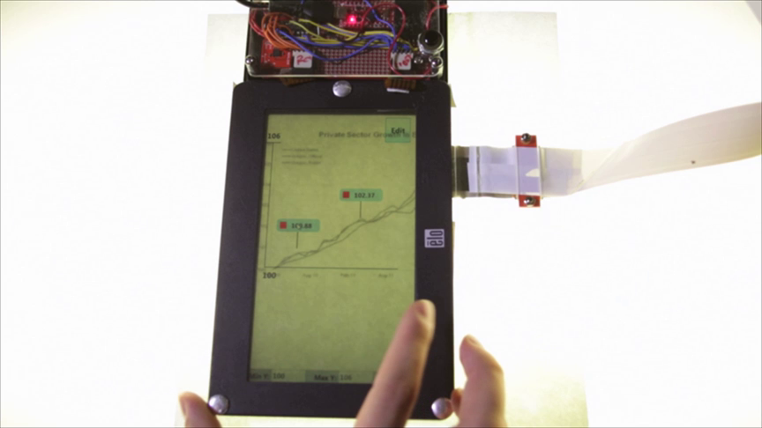
Overlay \ Querying \ GraphExplorer
Notes:
Configuring the scale of an underlying line chart enables users to query for particular values, facilitating analytical tasks.

Slide 11
Overlay
Dual-side Input/Output
Capture
Model
Notes:
The second category is dual-sided display and input interactions…

Slide 12
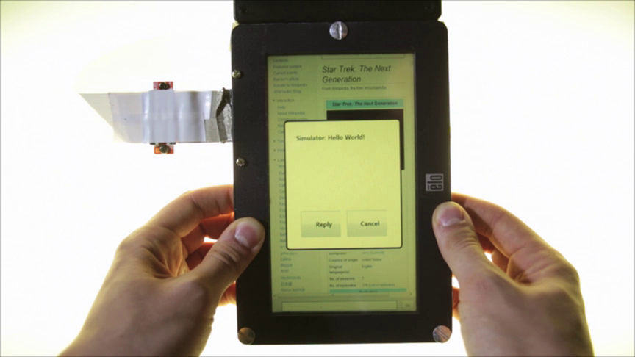
Dual-side Input and Output \ Flipping
Notes:
…and relates to the possibility to observe and use a transparent display from either side.
For example, users can launch a second application or answer notifications on the reverse side of the tPad.

Slide 13

Dual Input and Output \ Tap’N Flip
Notes:
Users can also copy and paste content from one side to the other by means of a Tap’N Flip gesture.

Slide 14

Overlay
Dual-side Input/Output
Capture
Model
Notes:
The third category is capture interactions…

Slide 15

Capture \ Grabbing
Notes:
…where the transparent display itself captures the objects below it.
For example, a grabbing interaction, captures and saves a picture.

Slide 16
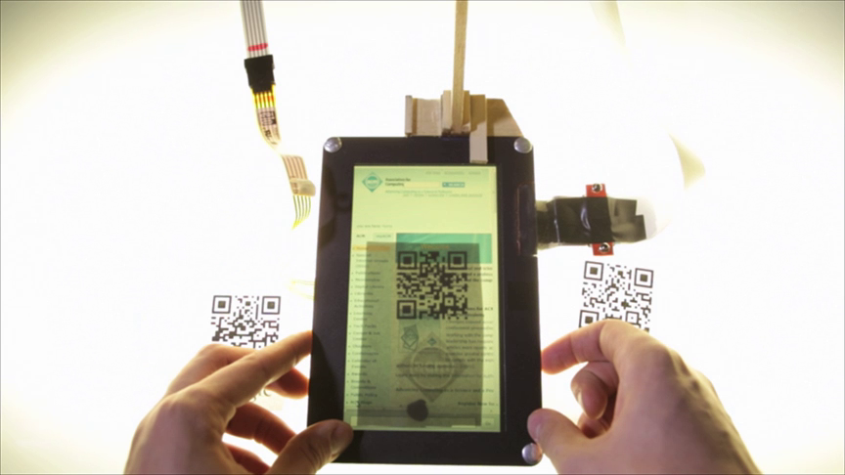
Capture \ Markers
Notes:
Surface capture also facilitates the use of markers, which are monitored by a background process and thus do not require explicit invocation of a reader app.

Slide 17
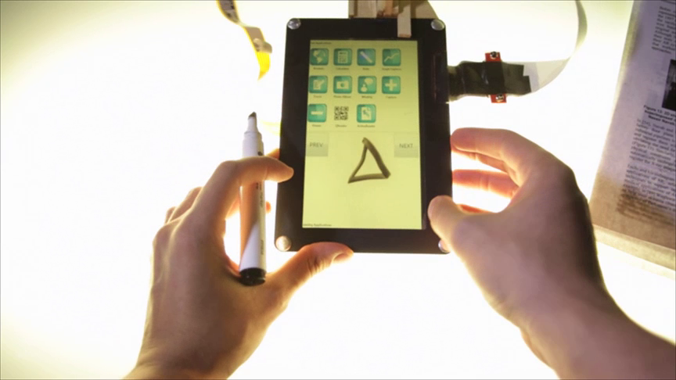
Capture \ Scribbles
Notes:
Similarly, hand-drawn scribbles can be interpreted as commands to the device.

Slide 18
Overlay
Dual-side Input/Output
Capture
Model
Notes:
The final category is model interactions…

Slide 19
Model \ Search
Notes:
…which use the surface capture image to provide contact-based augmented reality or c-AR interactions.
For example, users can tap on a printed word to search for other occurrences on the same page.

Slide 20
Model \ Annotations
Notes:
Users can also create highlights and hand scribbles that stay attached to a particular location of the document.

Slide 21
Model \ Area Triggers
Notes:
Finally, particular areas of the document can have associated content such as video which is triggered automatically.

Slide 22
tPad D
Notes:
We built two tPad prototypes, each of which facilitates new interaction possibilities.
Our first prototype, the tPad D, uses a low-opacity LCD display, two capacity touch sensors, and motion sensors to detect the interaction side.

Slide 23
tPad C
Notes:
Our second prototype, the tPad C, simulates surface capture by attaching an overhead camera.

Slide 24
Wide shot of the user in an application switching task
User Evaluation
Notes:
We demonstrate the benefits of tPad interactions for common everyday tasks on mobile devices.
We conducted two experiments and one survey study.

Slide 25
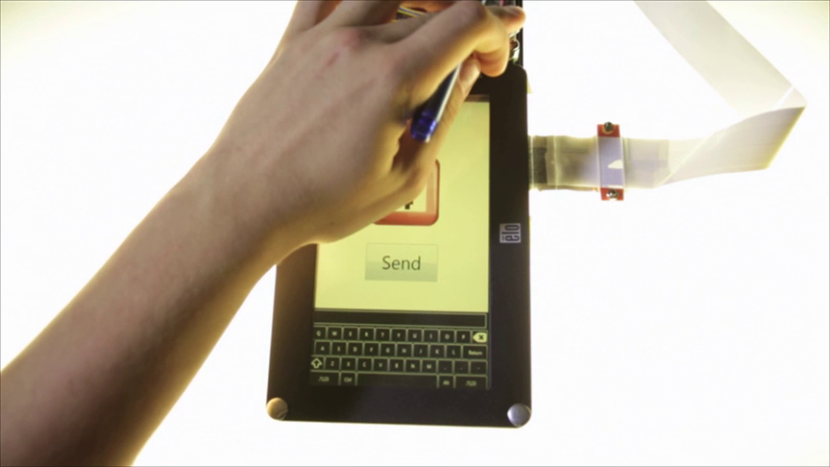
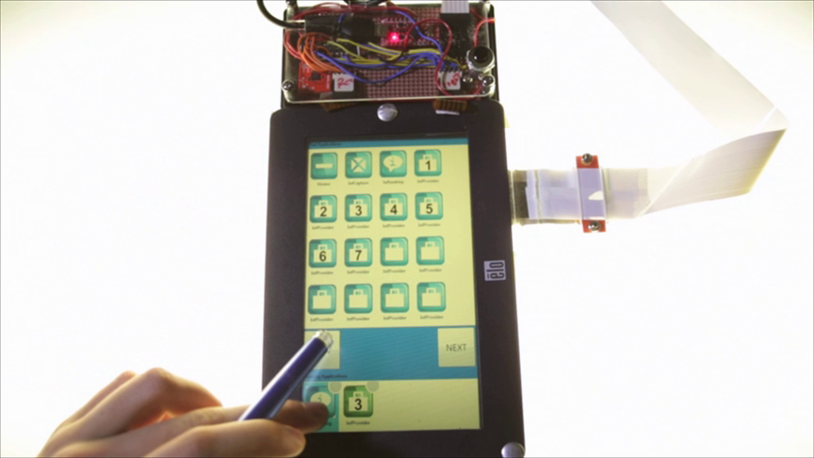
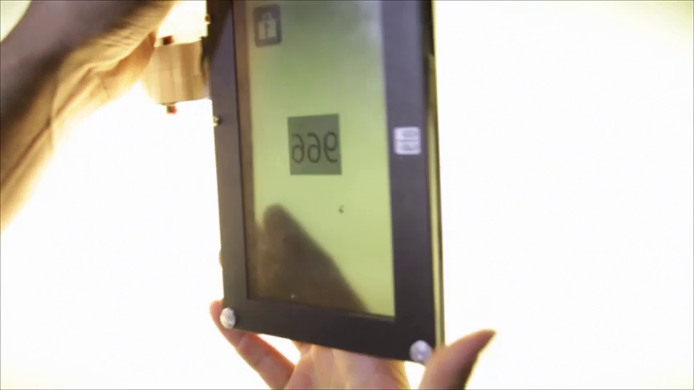
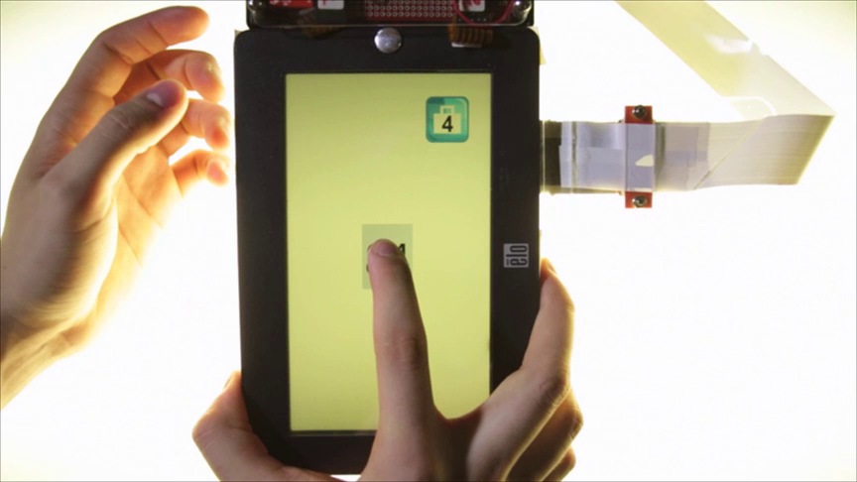
Home Button
Multitasking Bar
Flipping
Tap’N Flip
User Evaluation \ Multitasking
Notes:
In the first experiment, we looked at how tPads can support better multitasking by facilitating application switching.
We used an information seeking task, involving multiple applications at varying distances away from the tablet's home screen.
We compared the existing home button and multitask bar methods, to our proposed flipping and tap’n flip methods.
Results showed that multitasking using the tap’n flip method is faster than other methods, and this is true both when there are several applications involved and when the device has many applications installed.
Flipping alone was faster than pressing the home button, but as equally good as the multitasking bar.

Slide 26
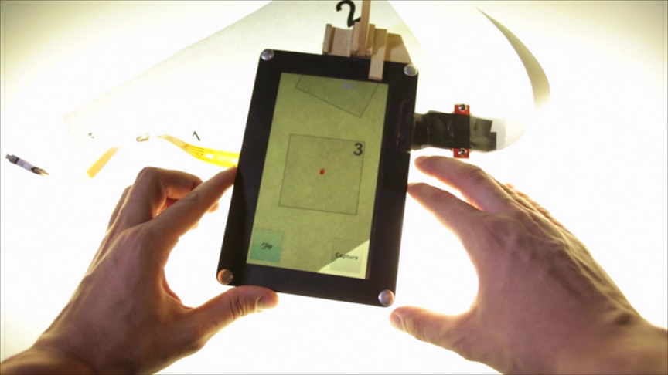
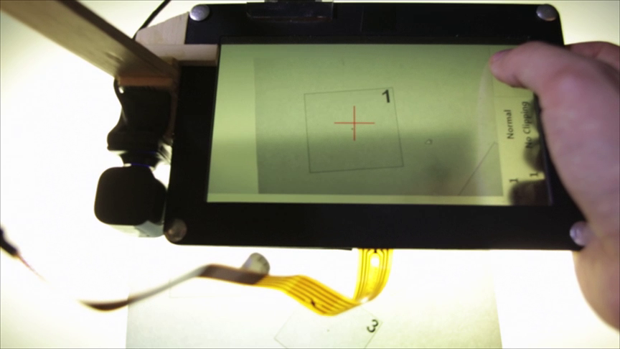
Surface Capture
Normal
User Evaluation \ Information Capture
Notes:
The second experiment looked the efficiency of taking a picture with surface capture versus a normal camera approach; and the effects of image cropping in both scenarios.
Results showed that for objects of all sizes, surface capture performed faster and users preferred it over, and found it more natural, than camera capture.

Slide 27
Check out the paper for details on:
4 interaction categories
tPad D and tPad C prototypes
Multitasking Evaluation
Information Capture Evaluation
User Feedback
Wide shot of the user using the tPad
Notes:
We presented 4 categories of interaction techniques for transparent-display tablet computers,
and demonstrated their functioning through 2 early prototypes.
Further, we demonstrated the benefit of these interaction capabilities in two everyday tasks such as application switching and information capture.
In both cases, transparent-display interactions outperform the existing alternatives.
Please see the paper for further details and user feedback.

